Slide 1


Airline Sentiment Analysis
Natural language processing
شريف أشرف أحمد رشدي
عبدالرحمن محمد خليل
محمد حسني مسعد
يحيى زكريا ابراهيم
صبيح صلاح صبيح

Slide 2
Content
Dataset information.
Preprocessing the data
(Tokenization, Removing Stopwords, Lemmatization/ Stemming ,loer case ).
Vectorization (tf/idf).
Using different classifiers
(SVM, Random Forest, Kneighbors, BernoulliNB, LogisticRegression , MultinomialNB,Voting).ode
Save Model
Check the model after load

Slide 3
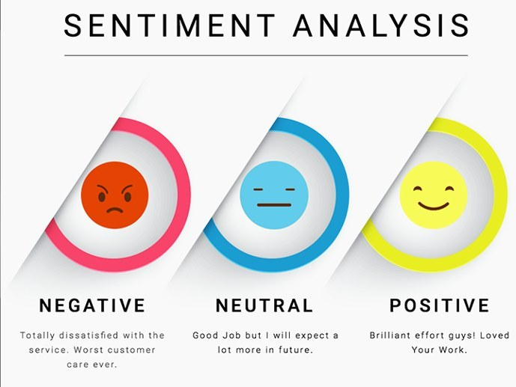
project is based on the sentiment analysis of airline data set which consists of reviews given by passengers of the particular airline and our classes consists of 3 sentiments which are negative, positive and neutral.

Slide 4
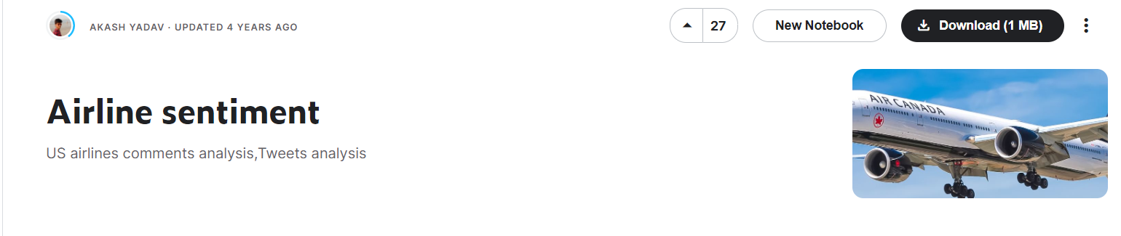
Dataset information.
Information about dataset
A dataset for US airlines comments analysis , Tweets analysis on Kaggle.
Dataset link:
Airline sentiment | Kaggle
This is US airlines data which contain comments of passengers on basis of service provided by airlines(6 airlines)

Slide 5
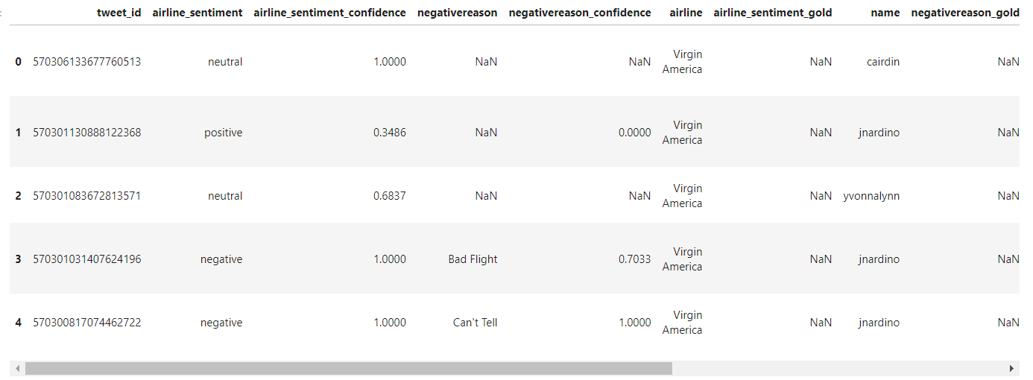
Dataset
Dataset have 15 features (tweet_id,airline_sentiment,airline_sentiment_confidence,negativereason,negativereason_confidence,airline, airline_sentiment_gold,name,negativereason_gold,retwee_count,text,tweet_created,tweet_location,user_timezone)

Slide 6
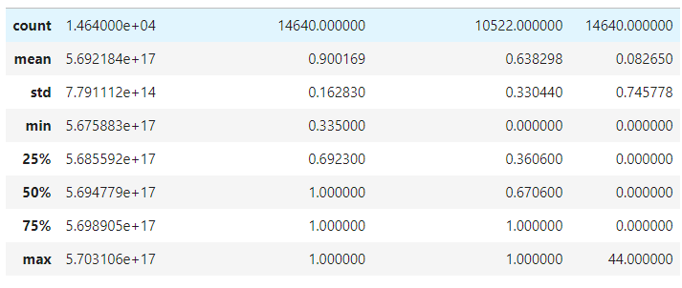
Dataset
show descriptive statistics include those that summarize the central tendency , dispersion and shape of a dataset distribution.

Slide 7
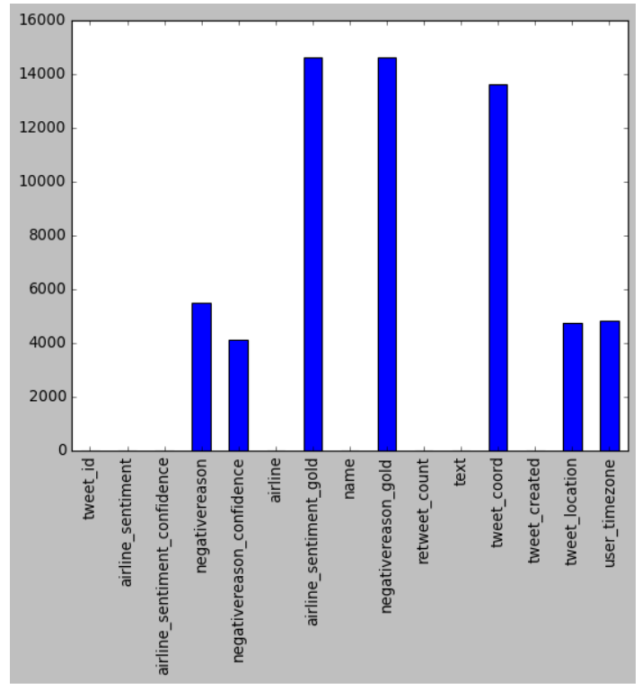
Dataset
Dataset check missing value

Slide 8
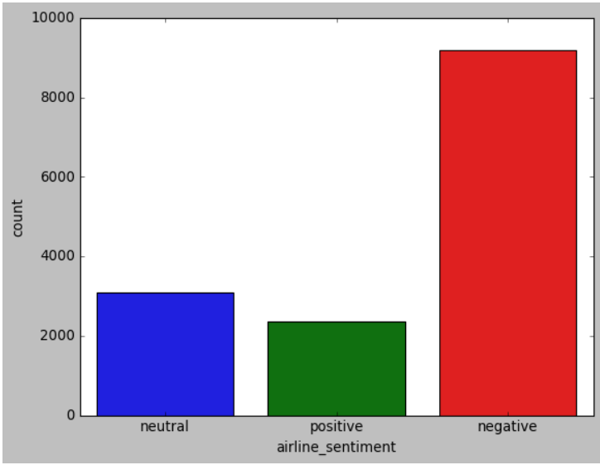
Dataset
Represent the number of output:(Checking for imbalanced output)

Slide 9
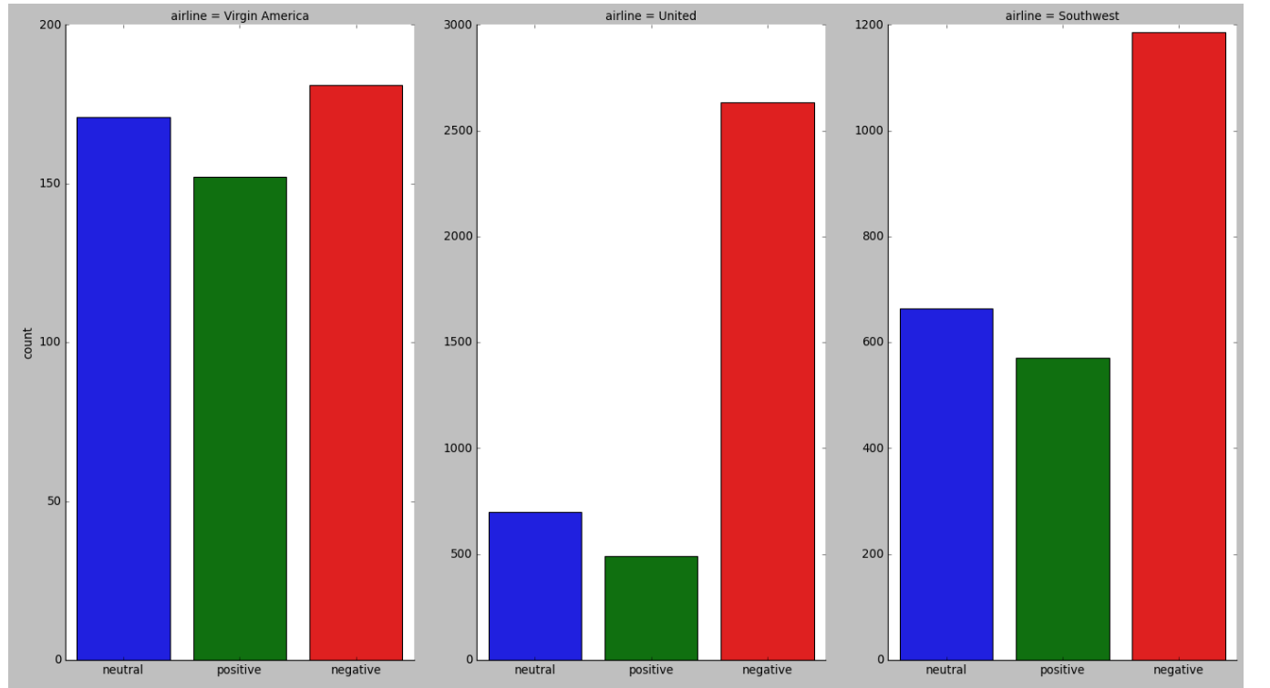
Dataset
Graphical representation of airline sentiment with airlines

Slide 10
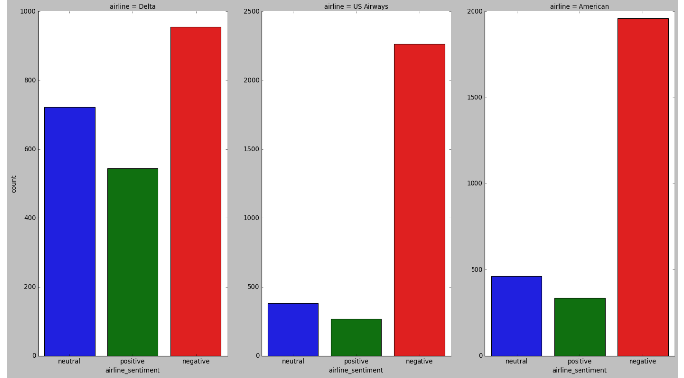
Dataset
Graphical representation of airline sentiment with airlines

Slide 11
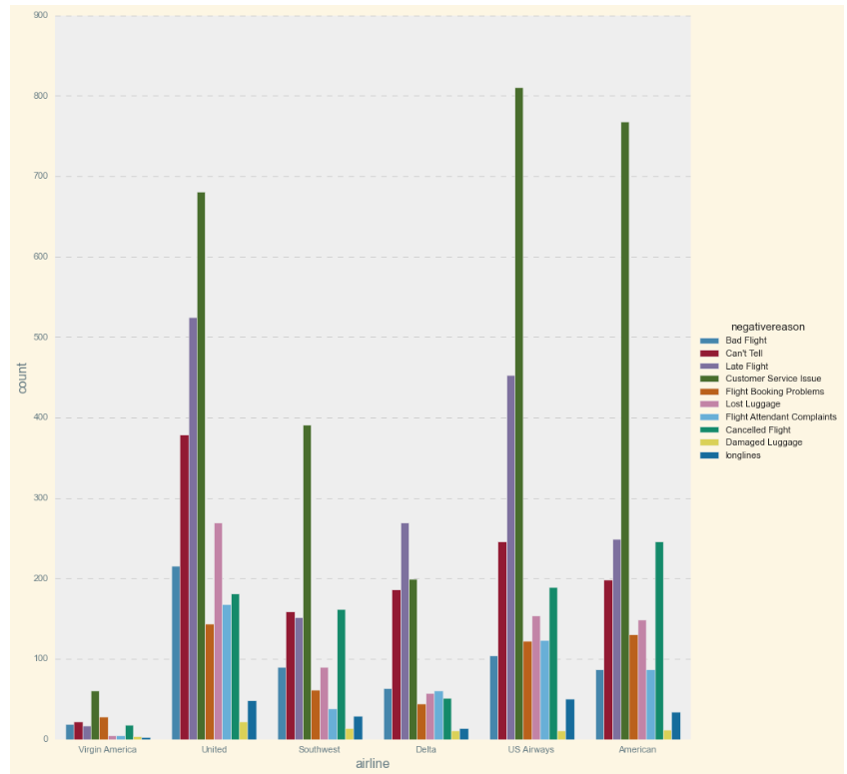
Dataset
Graphical representation of negative reason towards airlines

Slide 12
Dataset Preprocessing
The textual data we receive from the csv file consists of filler words which are not useful for us and has to be removed otherwise they will hinder the process.
Tokenization - It means converting our sentences into words so that they can be easily checked or compared for any update or removal.
Removing Stopwords - Removing stopwords is an important part of data preprocessing as these words are not useful and mainly disturbs our classifiers in choosing the import features as they dont have any meaning in the sentence like “the”,”I”,”has” etc.
Lemmatization/ Stemming - The root form of the word can be generated from both lemmatization and stem but stem is capable of generating a word that isn’t present in the dictionary. We have considered Lemmatization as it is more commonly used than stemming.

Slide 13
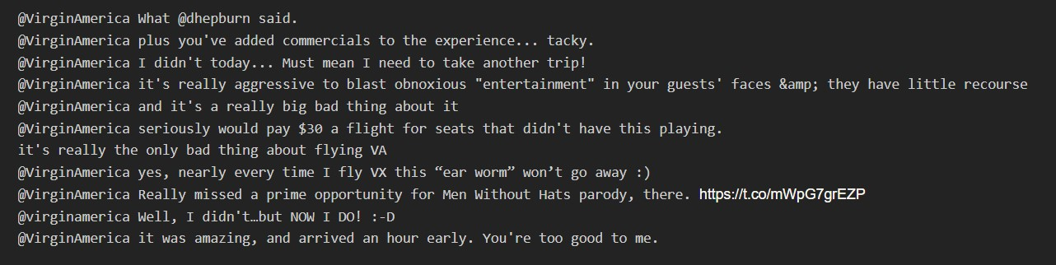
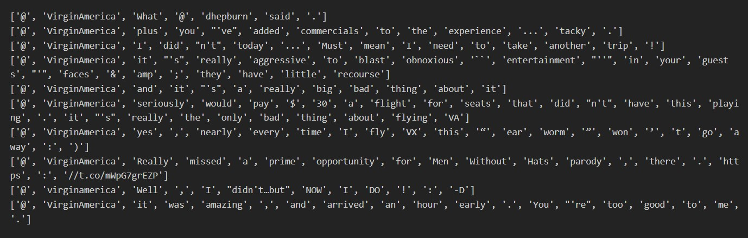
Tokenization
Dataset text.
Dataset text after word tokenize

Slide 14
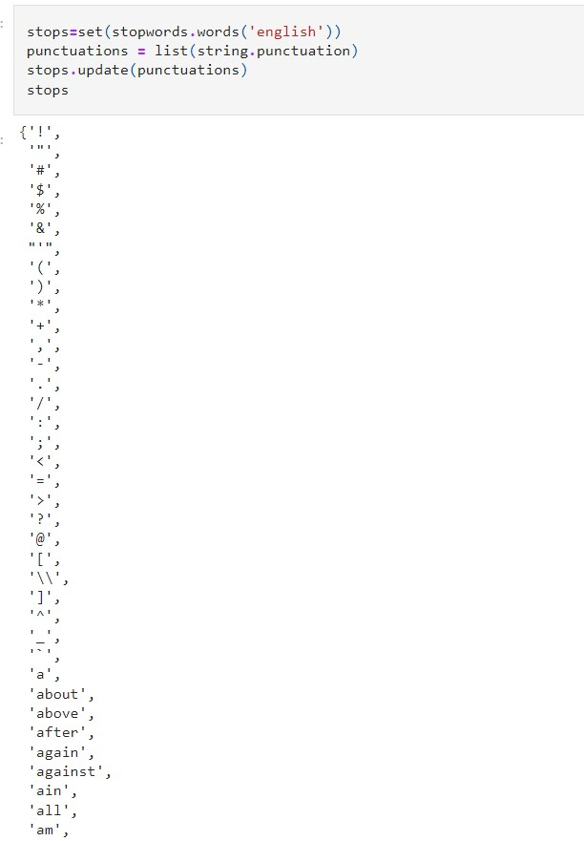
Stop words and punctuations. to remove

Slide 15
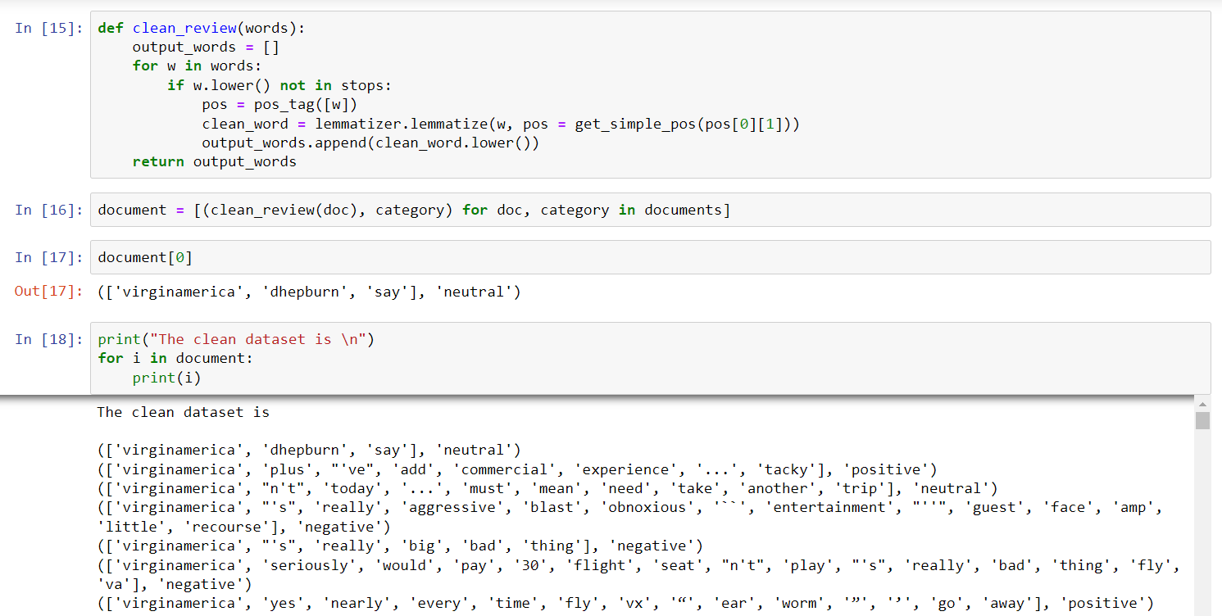
Apply Cleaning Dataset
TOKENIZING, LEMMATIZING, REMOVING STOPWORDS PUNCTUATIONS, pos.

Slide 16
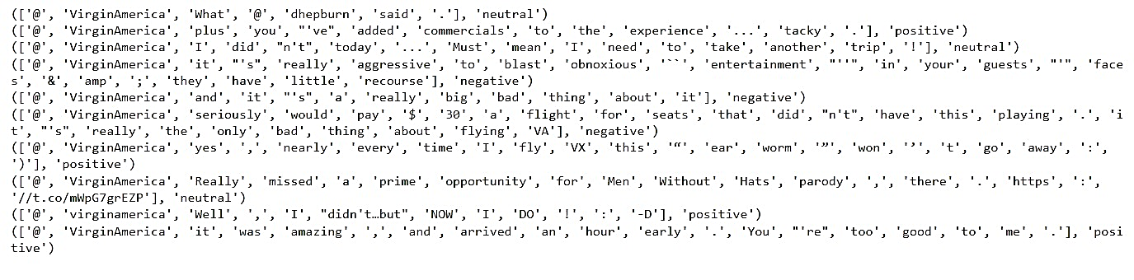
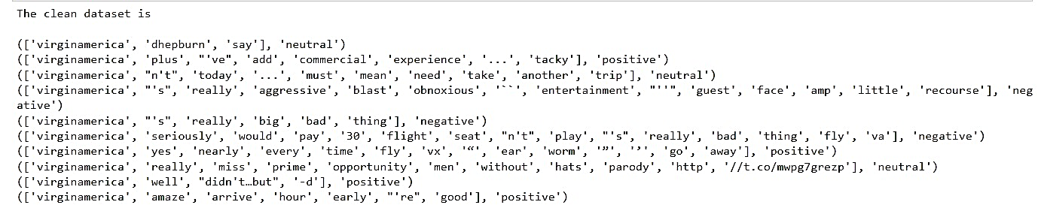
compare with data before and after clean
Before clean.
After clean.

Slide 17
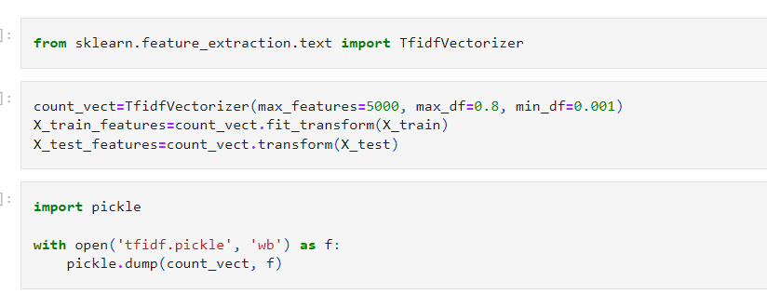
Vectorization
After than we have a list of lemmatized words, now starts the main problem how can we find the most frequency words the prerequisite for this is that the list
we chose the TF-IDF VECTORIZER.

Slide 18
classification models
Using different classifiers
SVM(Support Vector Machine) - Gives accuracy of 77%
Random Forest Classifier - Gives accuracy of 75%
KNeighbors- Gives accuracy of 74%
BernoulliNB- Gives accuracy of 76%
LogisticRegression- Gives accuracy of 78%
MultinomialNB- Gives accuracy of 75%
Making Voting to six Models- Gives accuracy of 75%

Slide 19
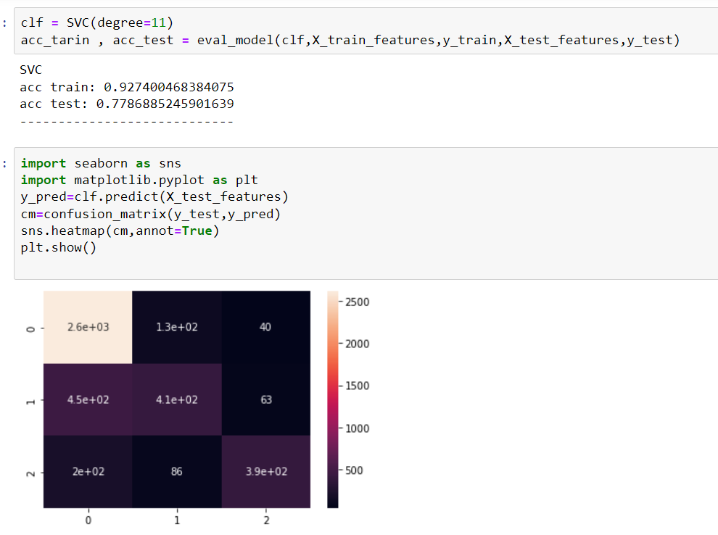
SVM(Support Vector Machine)

Slide 20
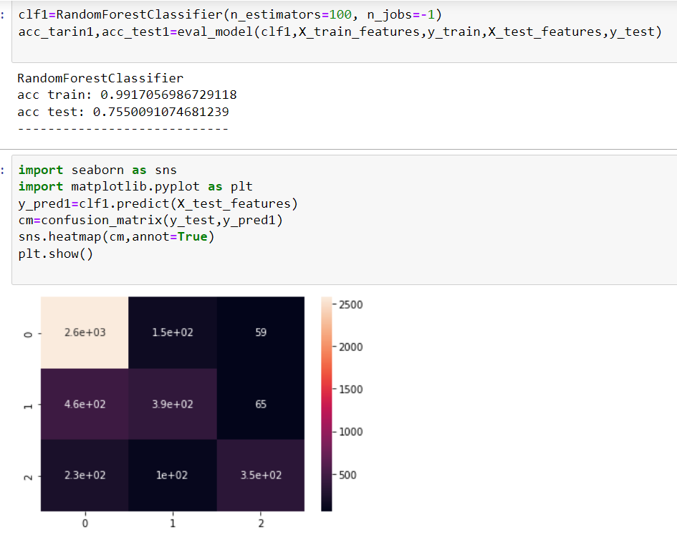
Random Forest Classifier

Slide 21
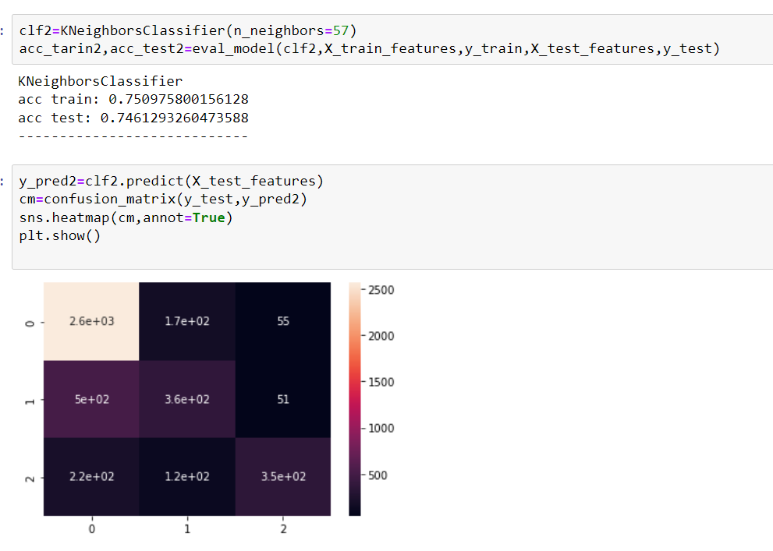
KNeighbors

Slide 22
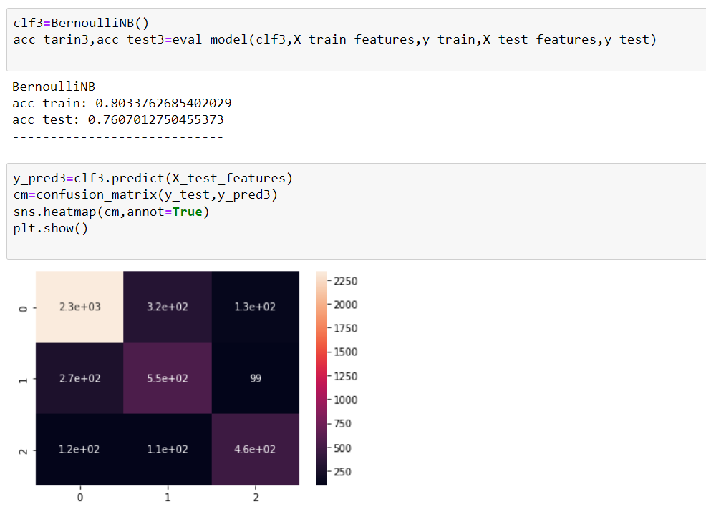
BernoulliNB

Slide 23
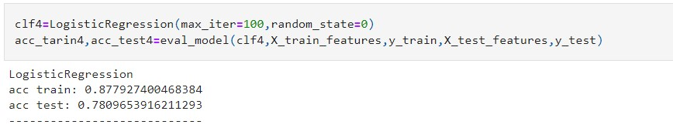
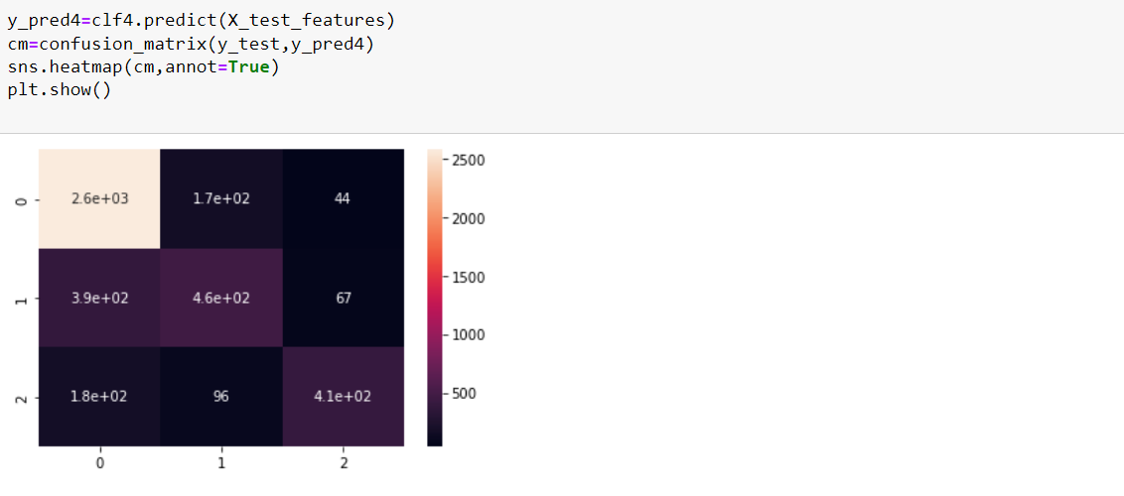
LogisticRegression

Slide 24
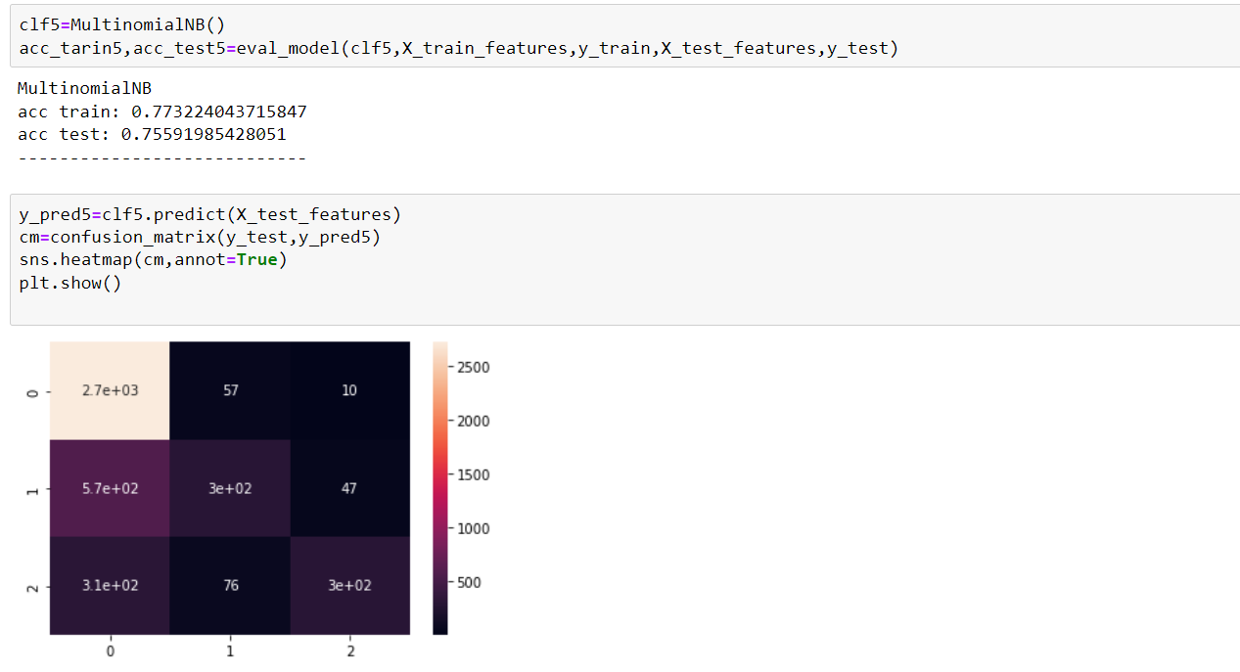
MultinomialNB

Slide 25
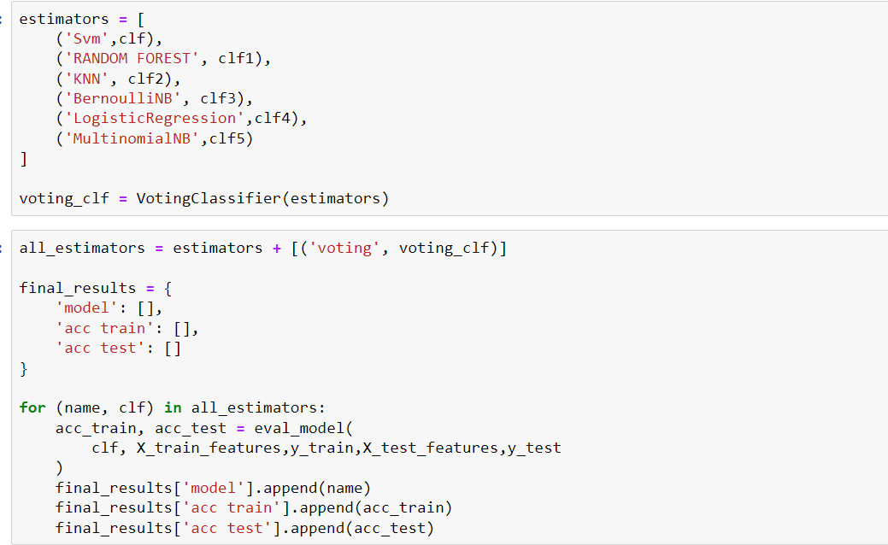

Voting to six Models

Slide 26
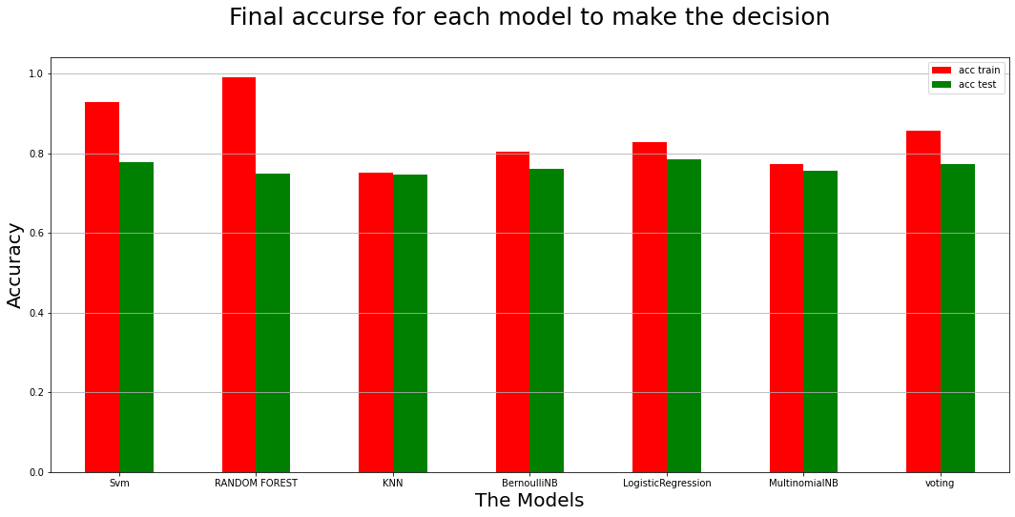
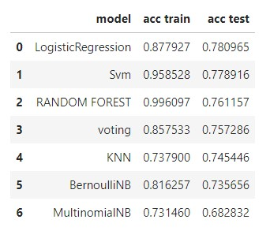
Final accurse for each model to make decision

Slide 27
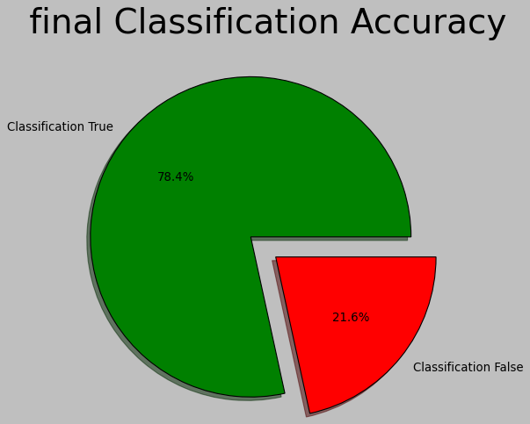
Final test using LogisticRegression.

Slide 28
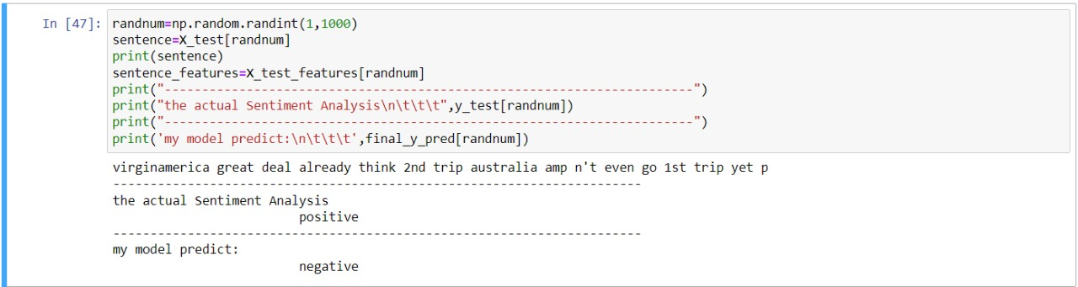
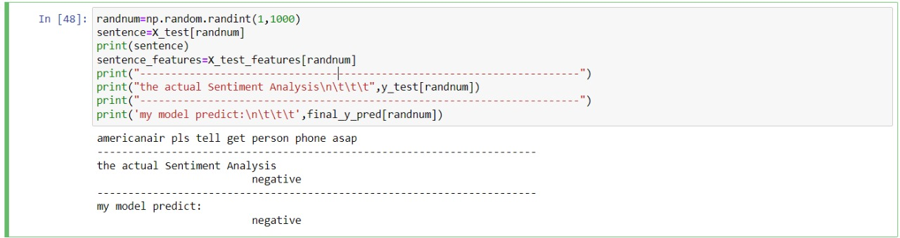
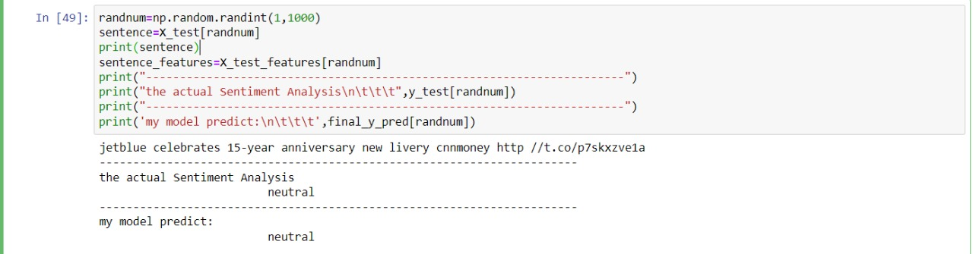
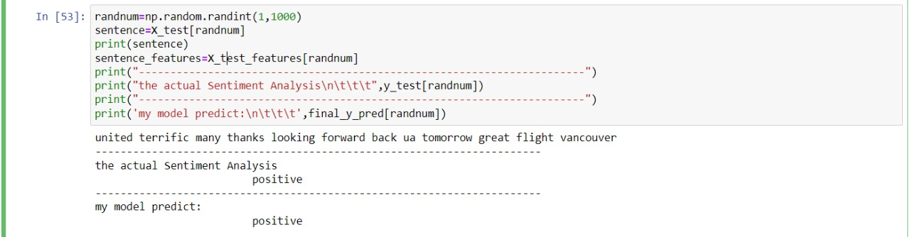
Test accuracy model

Slide 29
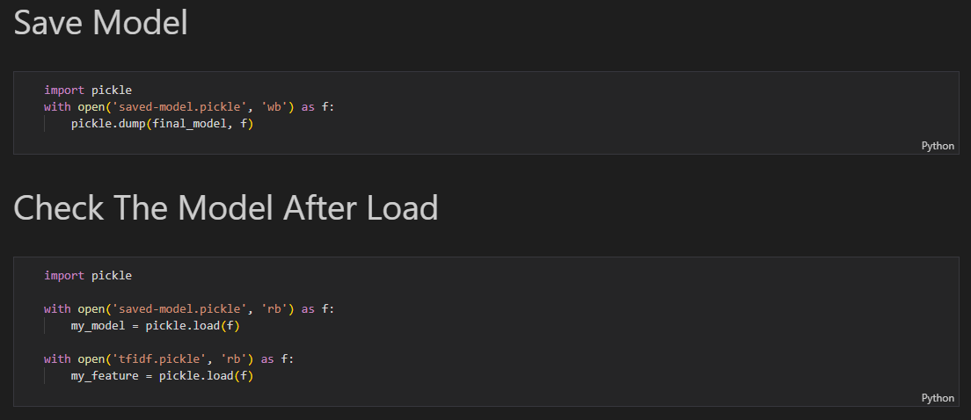
Save mode

Slide 30

♥♥ Thank you.♥♥

